Slide 1
Technical Support (420-1N6-AB) Introduction to computers
Fall 2023

Slide 2
Outline
What is a computer?
Computer Basics
Computer Hardware Components
Activities

Slide 3
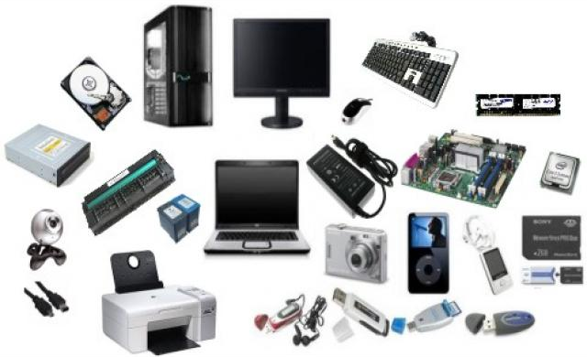
What is a computer?
Take a guess…

Slide 4
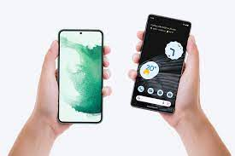
Is this a computer?
Yes!
Smartphones and tablets are hand-held computers, they have all the components of a computer in a very small and light size.

Slide 5
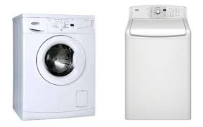
Is this a computer?
Yes!
A washing machine contains CPU, RAM and sets of codes to operate. It can even be reprogrammed and modern washing machines can be controlled using cellphones!

Slide 6
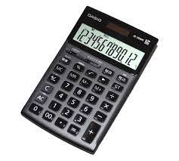
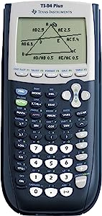
Is this a computer?
No!
Yes!
While calculators do have input keyboards and a screen, a basic calculator is only programmed to perform basic calculations. While a computer is programmable and allows programs to run and produce intermediate results that are stored in memory and reused at later time.

Slide 7
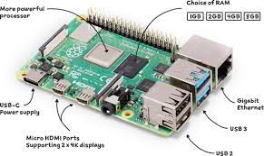
Is this a computer?
Yes! The Raspberry Pi is a credit-card-sized, single-board ARM nanocomputer.

Slide 8
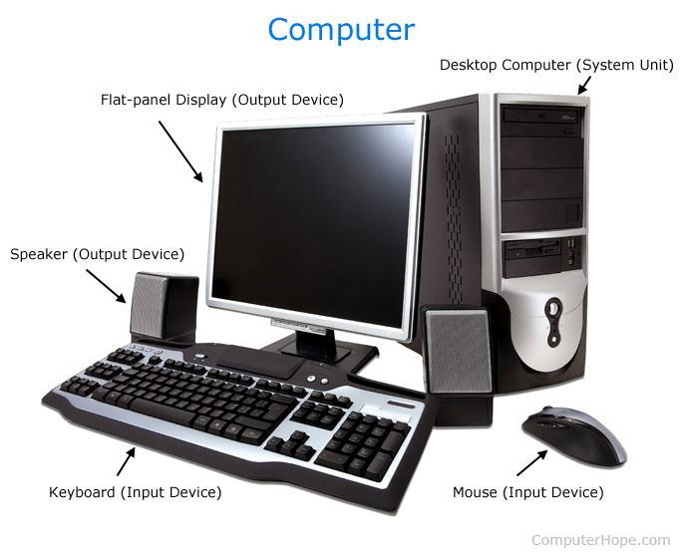
What is a computer - definition
A computer is an electromechanical device designed to (1) store information and (2) change that information through human and programmatic interaction (processes)
A computer almost always contains: (1) System Unit (CPU, RAM, Hard drives) and (2) Peripherals (Monitors, Keyboards, Mouse, etc.)

Slide 9
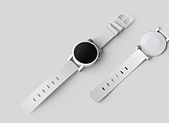
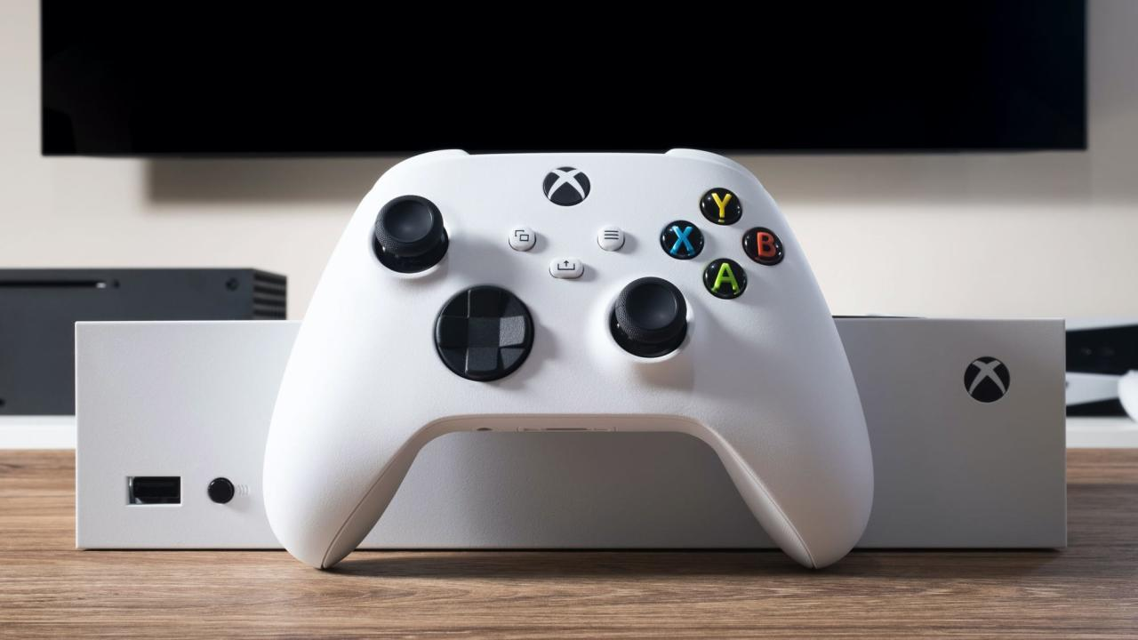
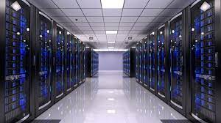
Other examples of computers…
Wearables: Fitness trackers, smart watches, etc.
Game consoles such as PS5, XBOX, Switch, etc.
Servers: these are large computers that serves up information to other computers on a network, whenever you use the internet, you are using data stored on server somewhere in the world.

Slide 10
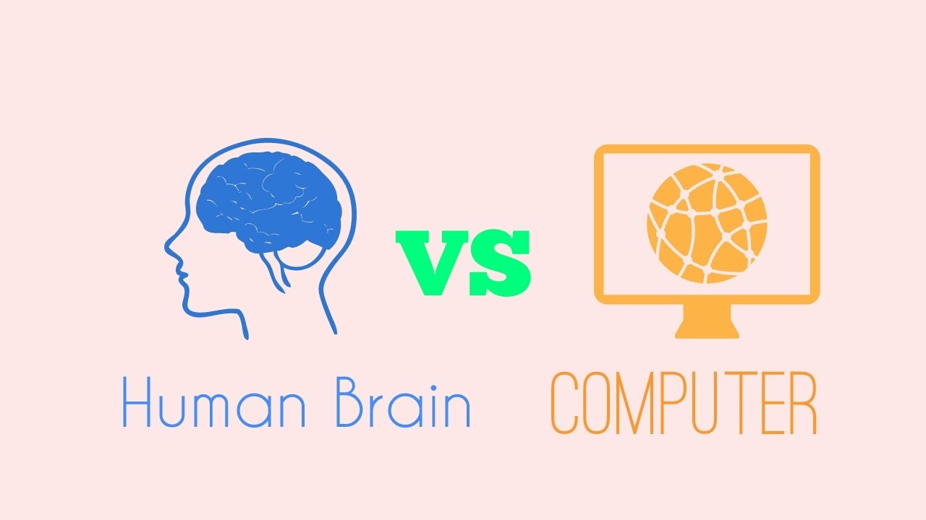
What is a computer – Basic properties
Deterministic: A given input reliably produces the same output every time
Digital: All “information” is represented by combinations of two different states (0 or 1, i.e., ON or OFF). This digital information can be shared between devices using cables (whether electrical or optical, as we will see)

Slide 11
A Historical Introduction (Bonus)
(Bonus) If you have two hours to spare, I highly recommend checking out “The Mother of All Demos”
If you have less than two hours to spare, just check out the highlight videos in the link below. Those are worthwhile too.
This is a 1968 presentation that introduced many of the hardware/graphics concepts we will see today and some we will see in future lectures: the mouse, networking, video conferencing, word documents, hyperlinks, gamer headphones…
https://www.dougengelbart.org/content/view/209/448/

Slide 12
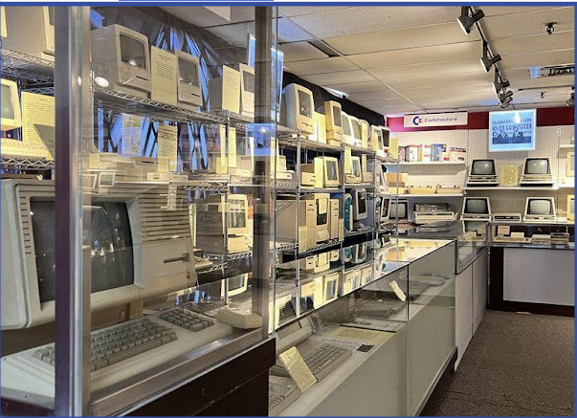
A museum of computers
E.musée Musée de l'Ordinateur
1055 Rue Bégin, Saint-Laurent, QC H4R 1V8

